Slide 1
Electronics Systems
(938II)
Lecture 4.1
Programmable Logic Devices – Principles and PAL

Slide 2
Introduction*
PLD = Programmable Logic Device
  Programming HW, not SW!
  Configurable logic elements that can implement different circuits
    Configuration #1 → circuit/logic function #1
    Configuration #2 → circuit/logic function #2
    …
  Not different pieces of HW, but the same piece of HW used in different ways!

Slide 3
Introduction*
PLD
  We have already seen some examples of programmable connections
    Fuses/anti-fuses
    MOS transistors
    …
  And how to program logic functions?

Slide 4

Principles of programmable logic*
Any combinational logic function can be represented by a Boolean expression
  Operators
    $+$ → OR (gate)
    $∙$ → AND (gate)
    → NOT (gate)
  Forms
    Sum-of-Products (SP)
    Product-of-Sums (PS)

Slide 5
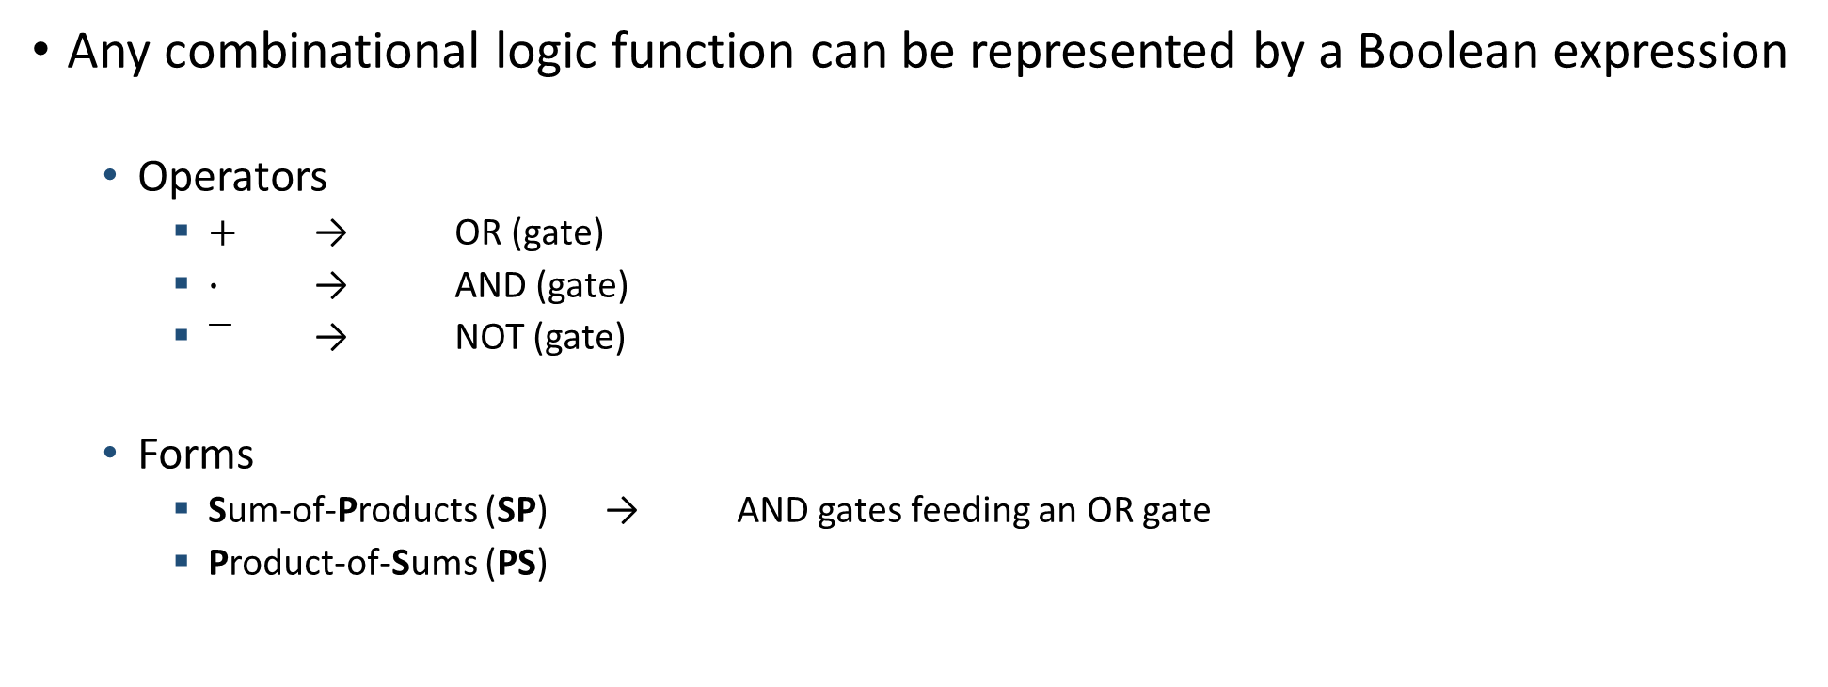
Principles of programmable logic
Any combinational logic function can be represented by a Boolean expression
  Operators
    $+$ → OR (gate)
    $∙$ → AND (gate)
    → NOT (gate)
  Forms
    Sum-of-Products (SP) → AND gates feeding an OR gate
    Product-of-Sums (PS)

Slide 6

Principles of programmable logic
Any combinational logic function can be represented by a Boolean expression
  Operators
    $+$ → OR (gate)
    $∙$ → AND (gate)
    → NOT (gate)
  Forms
    Sum-of-Products (SP) → AND gates feeding an OR gate →
    Product-of-Sums (PS)

Slide 7



Principles of programmable logic
Any combinational logic function can be represented by a Boolean expression
  Operators
    $+$ → OR (gate)
    $∙$ → AND (gate)
    → NOT (gate)
  Forms
    Sum-of-Products (SP) → AND gates feeding an OR gate →
    Product-of-Sums (PS)

Slide 8







Principles of programmable logic
Any combinational logic function can be represented by a Boolean expression
  Operators
    $+$ → OR (gate)
    $∙$ → AND (gate)
    → NOT (gate)
  Forms
    Sum-of-Products (SP) → AND gates feeding an OR gate →
    Product-of-Sums (PS)

Slide 9

Principles of programmable logic
Any combinational logic function can be represented by a Boolean expression
  Operators
    $+$ → OR (gate)
    $∙$ → AND (gate)
    → NOT (gate)
  Forms
    Sum-of-Products (SP)
    Product-of-Sums (PS) → OR gates feeding an AND gate

Slide 10

Principles of programmable logic
Any combinational logic function can be represented by a Boolean expression
  Operators
    $+$ → OR (gate)
    $∙$ → AND (gate)
    → NOT (gate)
  Forms
    Sum-of-Products (SP)
    Product-of-Sums (PS) → OR gates feeding an AND gate →

Slide 11


Principles of programmable logic
Any combinational logic function can be represented by a Boolean expression
  Operators
    $+$ → OR (gate)
    $∙$ → AND (gate)
    → NOT (gate)
  Forms
    Sum-of-Products (SP)
    Product-of-Sums (PS) → OR gates feeding an AND gate →

Slide 12






Principles of programmable logic
Any combinational logic function can be represented by a Boolean expression
  Operators
    $+$ → OR (gate)
    $∙$ → AND (gate)
    → NOT (gate)
  Forms
    Sum-of-Products (SP)
    Product-of-Sums (PS) → OR gates feeding an AND gate →

Slide 13
Principles of programmable logic
Example(s)
  Karnaugh map (KM or K-map) = graphical method to express logic functions as SP or PS

Slide 14
Principles of programmable logic
Example(s)
  Karnaugh map (KM or K-map) = graphical method to express logic functions as SP or PS
    Showing SP case

Slide 15

Principles of programmable logic
Example(s)
  Karnaugh map (KM or K-map) = graphical method to express logic functions as SP or PS
    Showing SP case
  Example #1
    $f_{1}\left(a,b\right)=a∙b$
    AND gate/function

Slide 16

Principles of programmable logic
Example(s)
  Karnaugh map (KM or K-map) = graphical method to express logic functions as SP or PS
    Showing SP case
  Example #1
    $f_{1}\left(a,b\right)=a∙b$
    AND gate/function
    Truth table
    KM
a | b | y
0 | 0 | 0
0 | 1 | 0
1 | 0 | 0
1 | 1 | 1

Slide 17
Principles of programmable logic
Example(s)
  Karnaugh map (KM or K-map) = graphical method to express logic functions as SP or PS
    Showing SP case
  Example #1
    $f_{1}\left(a,b\right)=a∙b$
    AND gate/function
    Truth table
    KM
a | b | y
0 | 0 | 0
0 | 1 | 0
1 | 0 | 0
1 | 1 | 1
 |  | b
 |  | 0 | 1
a | 0 | 0 | 0
 | 1 | 0 | 1

Slide 18
Principles of programmable logic
Example(s)
  Karnaugh map (KM or K-map) = graphical method to express logic functions as SP or PS
    Showing SP case
  Example #1
    $f_{1}\left(a,b\right)=a∙b$
    AND gate/function
    Truth table
    KM
a | b | y
0 | 0 | 0
0 | 1 | 0
1 | 0 | 0
1 | 1 | 1
 |  | b
 |  | 0 | 1
a | 0 | 0 | 0
 | 1 | 0 | 1

Slide 19
Principles of programmable logic
Example(s)
  Karnaugh map (KM or K-map) = graphical method to express logic functions as SP or PS
    Showing SP case
  Example #1
    $f_{1}\left(a,b\right)=a∙b$
    AND gate/function
    Truth table
    KM
a | b | y
0 | 0 | 0
0 | 1 | 0
1 | 0 | 0
1 | 1 | 1
 |  | b
 |  | 0 | 1
a | 0 | 0 | 0
 | 1 | 0 | 1

Slide 20
Principles of programmable logic
Example(s)
  Karnaugh map (KM or K-map) = graphical method to express logic functions as SP or PS
    Showing SP case
  Example #1
    $f_{1}\left(a,b\right)=a∙b$
    AND gate/function
    Truth table
    KM
a | b | y
0 | 0 | 0
0 | 1 | 0
1 | 0 | 0
1 | 1 | 1
 |  | b
 |  | 0 | 1
a | 0 | 0 | 0
 | 1 | 0 | 1

Slide 21
Principles of programmable logic
Example(s)
  Karnaugh map (KM or K-map) = graphical method to express logic functions as SP or PS
    Showing SP case
  Example #1
    $f_{1}\left(a,b\right)=a∙b$
    AND gate/function
    Truth table
    KM
a | b | y
0 | 0 | 0
0 | 1 | 0
1 | 0 | 0
1 | 1 | 1
 |  | b
 |  | 0 | 1
a | 0 | 0 | 0
 | 1 | 0 | 1

Slide 22

Principles of programmable logic
Example(s)
  Karnaugh map (KM or K-map) = graphical method to express logic functions as SP or PS
    Showing SP case
  Example #1
    $f_{1}\left(a,b\right)=a∙b$
    AND gate/function
    Truth table
    KM
How to
  Find all the largest group(s) of contiguous 1s
  For each group, select only the inputs whose value does not change
  Complement surviving inputs whose value is 0
  Multiply the surviving inputs → products $P_{i}$
  Sum the products
a | b | y
0 | 0 | 0
0 | 1 | 0
1 | 0 | 0
1 | 1 | 1
 |  | b
 |  | 0 | 1
a | 0 | 0 | 0
 | 1 | 0 | 1

Slide 23

Principles of programmable logic
Example(s)
  Karnaugh map (KM or K-map) = graphical method to express logic functions as SP or PS
    Showing SP case
  Example #1
    $f_{1}\left(a,b\right)=a∙b$
    AND gate/function
    Truth table
    KM
How to
  Find all the largest group(s) of contiguous 1s
  For each group, select only the inputs whose value does not change
  Complement surviving inputs whose value is 0
  Multiply the surviving inputs → products $P_{i}$
  Sum the products
a | b | y
0 | 0 | 0
0 | 1 | 0
1 | 0 | 0
1 | 1 | 1
 |  | b
 |  | 0 | 1
a | 0 | 0 | 0
 | 1 | 0 | 1

Slide 24

Principles of programmable logic
Example(s)
  Karnaugh map (KM or K-map) = graphical method to express logic functions as SP or PS
    Showing SP case
  Example #1
    $f_{1}\left(a,b\right)=a∙b$
    AND gate/function
    Truth table
    KM
How to
  Find all the largest group(s) of contiguous 1s
  For each group, select only the inputs whose value does not change
  Complement surviving inputs whose value is 0
  Multiply the surviving inputs → products $P_{i}$
  Sum the products
a | b | y
0 | 0 | 0
0 | 1 | 0
1 | 0 | 0
1 | 1 | 1
 |  | b
 |  | 0 | 1
a | 0 | 0 | 0
 | 1 | 0 | 1

Slide 25


Principles of programmable logic
Example(s)
  Karnaugh map (KM or K-map) = graphical method to express logic functions as SP or PS
    Showing SP case
  Example #1
    $f_{1}\left(a,b\right)=a∙b$
    AND gate/function
    Truth table
    KM
How to
  Find all the largest group(s) of contiguous 1s
  For each group, select only the inputs whose value does not change
  Complement surviving inputs whose value is 0
  Multiply the surviving inputs → products $P_{i}$
  Sum the products
a | b | y
0 | 0 | 0
0 | 1 | 0
1 | 0 | 0
1 | 1 | 1
 |  | b
 |  | 0 | 1
a | 0 | 0 | 0
 | 1 | 0 | 1

Slide 26

Principles of programmable logic
Example(s)
  Karnaugh map (KM or K-map) = graphical method to express logic functions as SP or PS
    Showing SP case
  Example #1
    $f_{1}\left(a,b\right)=a∙b$
    AND gate/function
    Truth table
    KM
How to
  Find all the largest group(s) of contiguous 1s
  For each group, select only the inputs whose value does not change
  Complement surviving inputs whose value is 0
  Multiply the surviving inputs → products $P_{i}$
  Sum the products
a | b | y
0 | 0 | 0
0 | 1 | 0
1 | 0 | 0
1 | 1 | 1
 |  | b
 |  | 0 | 1
a | 0 | 0 | 0
 | 1 | 0 | 1

Slide 27


Principles of programmable logic
Example(s)
  Karnaugh map (KM or K-map) = graphical method to express logic functions as SP or PS
    Showing SP case
  Example #1
    $f_{1}\left(a,b\right)=a∙b$
    AND gate/function
    Truth table
    KM
How to
  Find all the largest group(s) of contiguous 1s
  For each group, select only the inputs whose value does not change
  Complement surviving inputs whose value is 0
  Multiply the surviving inputs → products $P_{i}$
  Sum the products
a | b | y
0 | 0 | 0
0 | 1 | 0
1 | 0 | 0
1 | 1 | 1
 |  | b
 |  | 0 | 1
a | 0 | 0 | 0
 | 1 | 0 | 1

Slide 28




Principles of programmable logic
Example(s)
  Karnaugh map (KM or K-map) = graphical method to express logic functions as SP or PS
    Showing SP case
  Example #1
    $f_{1}\left(a,b\right)=a∙b$
    AND gate/function
    Truth table
    KM
Logic circuit
a | b | y
0 | 0 | 0
0 | 1 | 0
1 | 0 | 0
1 | 1 | 1
 |  | b
 |  | 0 | 1
a | 0 | 0 | 0
 | 1 | 0 | 1
a
y
b

Slide 29


Principles of programmable logic
Example(s)
  Karnaugh map (KM or K-map) = graphical method to express logic functions as SP or PS
    Showing SP case
  Example #2
    $f_{2}\left(a,b\right)= ??$
    Truth table
    KM
How to
  Find all the largest group(s) of contiguous 1s
  For each group, select only the inputs whose value does not change
  Complement surviving inputs whose value is 0
  Multiply the surviving inputs → products $P_{i}$
  Sum the products
a | b | y
0 | 0 | 0
0 | 1 | 0
1 | 0 | 1
1 | 1 | 1
 |  | b
 |  | 0 | 1
a | 0 | 0 | 0
 | 1 | 1 | 1

Slide 30
Principles of programmable logic
Example(s)
  Karnaugh map (KM or K-map) = graphical method to express logic functions as SP or PS
    Showing SP case
  Example #2
    $f_{2}\left(a,b\right)= ??$
    Truth table
    KM
How to
  Find all the largest group(s) of contiguous 1s
  For each group, select only the inputs whose value does not change
  Complement surviving inputs whose value is 0
  Multiply the surviving inputs → products $P_{i}$
  Sum the products
a | b | y
0 | 0 | 0
0 | 1 | 0
1 | 0 | 1
1 | 1 | 1
 |  | b
 |  | 0 | 1
a | 0 | 0 | 0
 | 1 | 1 | 1

Slide 31
Principles of programmable logic
Example(s)
  Karnaugh map (KM or K-map) = graphical method to express logic functions as SP or PS
    Showing SP case
  Example #2
    $f_{2}\left(a,b\right)= ??$
    Truth table
    KM
How to
  Find all the largest group(s) of contiguous 1s
  For each group, select only the inputs whose value does not change
  Complement surviving inputs whose value is 0
  Multiply the surviving inputs → products $P_{i}$
  Sum the products
a | b | y
0 | 0 | 0
0 | 1 | 0
1 | 0 | 1
1 | 1 | 1
 |  | b
 |  | 0 | 1
a | 0 | 0 | 0
 | 1 | 1 | 1

Slide 32
Principles of programmable logic
Example(s)
  Karnaugh map (KM or K-map) = graphical method to express logic functions as SP or PS
    Showing SP case
  Example #2
    $f_{2}\left(a,b\right)= ??$
    Truth table
    KM
How to
  Find all the largest group(s) of contiguous 1s
  For each group, select only the inputs whose value does not change
  Complement surviving inputs whose value is 0
  Multiply the surviving inputs → products $P_{i}$
  Sum the products
a | b | y
0 | 0 | 0
0 | 1 | 0
1 | 0 | 1
1 | 1 | 1
 |  | b
 |  | 0 | 1
a | 0 | 0 | 0
 | 1 | 1 | 1

Slide 33
Principles of programmable logic
Example(s)
  Karnaugh map (KM or K-map) = graphical method to express logic functions as SP or PS
    Showing SP case
  Example #2
    $f_{2}\left(a,b\right)= ??$
    Truth table
    KM
How to
  Find all the largest group(s) of contiguous 1s
  For each group, select only the inputs whose value does not change
  Complement surviving inputs whose value is 0
  Multiply the surviving inputs → products $P_{i}$
  Sum the products
a | b | y
0 | 0 | 0
0 | 1 | 0
1 | 0 | 1
1 | 1 | 1
 |  | b
 |  | 0 | 1
a | 0 | 0 | 0
 | 1 | 1 | 1

Slide 34

Principles of programmable logic
Example(s)
  Karnaugh map (KM or K-map) = graphical method to express logic functions as SP or PS
    Showing SP case
  Example #2
    $f_{2}\left(a,b\right)=a$
    Truth table
    KM
How to
  Find all the largest group(s) of contiguous 1s
  For each group, select only the inputs whose value does not change
  Complement surviving inputs whose value is 0
  Multiply the surviving inputs → products $P_{i}$
  Sum the products
a | b | y
0 | 0 | 0
0 | 1 | 0
1 | 0 | 1
1 | 1 | 1
 |  | b
 |  | 0 | 1
a | 0 | 0 | 0
 | 1 | 1 | 1

Slide 35
Principles of programmable logic
Example(s)
  Karnaugh map (KM or K-map) = graphical method to express logic functions as SP or PS
    Showing SP case
  Example #2
    $f_{2}\left(a,b\right)=a$
    Truth table
    KM
Logic circuit
a | b | y
0 | 0 | 0
0 | 1 | 0
1 | 0 | 1
1 | 1 | 1
 |  | b
 |  | 0 | 1
a | 0 | 0 | 0
 | 1 | 1 | 1
a
y

Slide 36

Principles of programmable logic
Example(s)
  Karnaugh map (KM or K-map) = graphical method to express logic functions as SP or PS
    Showing SP case
  Example #3
    $f_{3}\left(a,b\right)= ??$
    Truth table
    KM
How to
  Find all the largest group(s) of contiguous 1s
  For each group, select only the inputs whose value does not change
  Complement surviving inputs whose value is 0
  Multiply the surviving inputs → products $P_{i}$
  Sum the products
a | b | y
0 | 0 | 1
0 | 1 | 1
1 | 0 | 0
1 | 1 | 0
 |  | b
 |  | 0 | 1
a | 0 | 1 | 1
 | 1 | 0 | 0

Slide 37

Principles of programmable logic
Example(s)
  Karnaugh map (KM or K-map) = graphical method to express logic functions as SP or PS
    Showing SP case
  Example #3
    $f_{3}\left(a,b\right)= ??$
    Truth table
    KM
How to
  Find all the largest group(s) of contiguous 1s
  For each group, select only the inputs whose value does not change
  Complement surviving inputs whose value is 0
  Multiply the surviving inputs → products $P_{i}$
  Sum the products
a | b | y
0 | 0 | 1
0 | 1 | 1
1 | 0 | 0
1 | 1 | 0
 |  | b
 |  | 0 | 1
a | 0 | 1 | 1
 | 1 | 0 | 0

Slide 38
Principles of programmable logic
Example(s)
  Karnaugh map (KM or K-map) = graphical method to express logic functions as SP or PS
    Showing SP case
  Example #3
    $f_{3}\left(a,b\right)= ??$
    Truth table
    KM
How to
  Find all the largest group(s) of contiguous 1s
  For each group, select only the inputs whose value does not change
  Complement surviving inputs whose value is 0
  Multiply the surviving inputs → products $P_{i}$
  Sum the products
a | b | y
0 | 0 | 1
0 | 1 | 1
1 | 0 | 0
1 | 1 | 0
 |  | b
 |  | 0 | 1
a | 0 | 1 | 1
 | 1 | 0 | 0

Slide 39
Principles of programmable logic
Example(s)
  Karnaugh map (KM or K-map) = graphical method to express logic functions as SP or PS
    Showing SP case
  Example #3
    $f_{3}\left(a,b\right)= ??$
    Truth table
    KM
How to
  Find all the largest group(s) of contiguous 1s
  For each group, select only the inputs whose value does not change
  Complement surviving inputs whose value is 0
  Multiply the surviving inputs → products $P_{i}$
  Sum the products
a | b | y
0 | 0 | 1
0 | 1 | 1
1 | 0 | 0
1 | 1 | 0
 |  | b
 |  | 0 | 1
a | 0 | 1 | 1
 | 1 | 0 | 0

Slide 40
Principles of programmable logic
Example(s)
  Karnaugh map (KM or K-map) = graphical method to express logic functions as SP or PS
    Showing SP case
  Example #3
    $f_{3}\left(a,b\right)= ??$
    Truth table
    KM
How to
  Find all the largest group(s) of contiguous 1s
  For each group, select only the inputs whose value does not change
  Complement surviving inputs whose value is 0
  Multiply the surviving inputs → products $P_{i}$
  Sum the products
a | b | y
0 | 0 | 1
0 | 1 | 1
1 | 0 | 0
1 | 1 | 0
 |  | b
 |  | 0 | 1
a | 0 | 1 | 1
 | 1 | 0 | 0

Slide 41

Principles of programmable logic
Example(s)
  Karnaugh map (KM or K-map) = graphical method to express logic functions as SP or PS
    Showing SP case
  Example #3
    $f_{3}\left(a,b\right)=\overline{a}$
    Truth table
    KM
How to
  Find all the largest group(s) of contiguous 1s
  For each group, select only the inputs whose value does not change
  Complement surviving inputs whose value is 0
  Multiply the surviving inputs → products $P_{i}$
  Sum the products
a | b | y
0 | 0 | 1
0 | 1 | 1
1 | 0 | 0
1 | 1 | 0
 |  | b
 |  | 0 | 1
a | 0 | 1 | 1
 | 1 | 0 | 0

Slide 42
Principles of programmable logic
Example(s)
  Karnaugh map (KM or K-map) = graphical method to express logic functions as SP or PS
    Showing SP case
  Example #3
    $f_{3}\left(a,b\right)=\overline{a}$
    Truth table
    KM
Logic circuit
a | b | y
0 | 0 | 1
0 | 1 | 1
1 | 0 | 0
1 | 1 | 0
 |  | b
 |  | 0 | 1
a | 0 | 1 | 1
 | 1 | 0 | 0
a
y

Slide 43

Principles of programmable logic
Example(s)
  Karnaugh map (KM or K-map) = graphical method to express logic functions as SP or PS
    Showing SP case
  Example #4
    $f_{4}\left(a,b\right)= ??$
    Truth table
    KM
How to
  Find all the largest group(s) of contiguous 1s
  For each group, select only the inputs whose value does not change
  Complement surviving inputs whose value is 0
  Multiply the surviving inputs → products $P_{i}$
  Sum the products
a | b | y
0 | 0 | 1
0 | 1 | 1
1 | 0 | 0
1 | 1 | 1
 |  | b
 |  | 0 | 1
a | 0 | 1 | 1
 | 1 | 0 | 1

Slide 44
Principles of programmable logic
Example(s)
  Karnaugh map (KM or K-map) = graphical method to express logic functions as SP or PS
    Showing SP case
  Example #4
    $f_{4}\left(a,b\right)= ??$
    Truth table
    KM
How to
  Find all the largest group(s) of contiguous 1s
  For each group, select only the inputs whose value does not change
  Complement surviving inputs whose value is 0
  Multiply the surviving inputs → products $P_{i}$
  Sum the products
a | b | y
0 | 0 | 1
0 | 1 | 1
1 | 0 | 0
1 | 1 | 1
 |  | b
 |  | 0 | 1
a | 0 | 1 | 1
 | 1 | 0 | 1

Slide 45

Principles of programmable logic
Example(s)
  Karnaugh map (KM or K-map) = graphical method to express logic functions as SP or PS
    Showing SP case
  Example #4
    $f_{4}\left(a,b\right)= ??$
    Truth table
    KM
How to
  Find all the largest group(s) of contiguous 1s
  For each group, select only the inputs whose value does not change
  Complement surviving inputs whose value is 0
  Multiply the surviving inputs → products $P_{i}$
  Sum the products
a | b | y
0 | 0 | 1
0 | 1 | 1
1 | 0 | 0
1 | 1 | 1
 |  | b
 |  | 0 | 1
a | 0 | 1 | 1
 | 1 | 0 | 1

Slide 46
Principles of programmable logic
Example(s)
  Karnaugh map (KM or K-map) = graphical method to express logic functions as SP or PS
    Showing SP case
  Example #4
    $f_{4}\left(a,b\right)= ??$
    Truth table
    KM
How to
  Find all the largest group(s) of contiguous 1s
  For each group, select only the inputs whose value does not change
  Complement surviving inputs whose value is 0
  Multiply the surviving inputs → products $P_{i}$
  Sum the products
a | b | y
0 | 0 | 1
0 | 1 | 1
1 | 0 | 0
1 | 1 | 1
 |  | b
 |  | 0 | 1
a | 0 | 1 | 1
 | 1 | 0 | 1

Slide 47
Principles of programmable logic
Example(s)
  Karnaugh map (KM or K-map) = graphical method to express logic functions as SP or PS
    Showing SP case
  Example #4
    $f_{4}\left(a,b\right)= ??$
    Truth table
    KM
How to
  Find all the largest group(s) of contiguous 1s
  For each group, select only the inputs whose value does not change
  Complement surviving inputs whose value is 0
  Multiply the surviving inputs → products $P_{i}$
  Sum the products
a | b | y
0 | 0 | 1
0 | 1 | 1
1 | 0 | 0
1 | 1 | 1
 |  | b
 |  | 0 | 1
a | 0 | 1 | 1
 | 1 | 0 | 1

Slide 48

Principles of programmable logic
Example(s)
  Karnaugh map (KM or K-map) = graphical method to express logic functions as SP or PS
    Showing SP case
  Example #4
    $f_{4}\left(a,b\right)=\overline{a}+b$
    Truth table
    KM
How to
  Find all the largest group(s) of contiguous 1s
  For each group, select only the inputs whose value does not change
  Complement surviving inputs whose value is 0
  Multiply the surviving inputs → products $P_{i}$
  Sum the products
a | b | y
0 | 0 | 1
0 | 1 | 1
1 | 0 | 0
1 | 1 | 1
 |  | b
 |  | 0 | 1
a | 0 | 1 | 1
 | 1 | 0 | 1

Slide 49
Principles of programmable logic
Example(s)
  Karnaugh map (KM or K-map) = graphical method to express logic functions as SP or PS
    Showing SP case
  Example #4
    $f_{4}\left(a,b\right)=\overline{a}+b$
    Truth table
    KM
Logic circuit
a | b | y
0 | 0 | 1
0 | 1 | 1
1 | 0 | 0
1 | 1 | 1
 |  | b
 |  | 0 | 1
a | 0 | 1 | 1
 | 1 | 0 | 1
a
b
y

Slide 50


Principles of programmable logic
Example(s)
  Karnaugh map (KM or K-map) = graphical method to express logic functions as SP or PS
    Showing SP case
  Example #5
    $f_{5}\left(a,b\right)= ??$
    Truth table
    KM
a | b | c | y
0 | 0 | 0 | 0
0 | 0 | 1 | 1
0 | 1 | 0 | 0
0 | 1 | 1 | 1
1 | 0 | 0 | 0
1 | 0 | 1 | 0
1 | 1 | 0 | 0
1 | 1 | 1 | 1
 |  | bc
 |  | 00 | 01 | 11 | 10
a | 0 | 0 | 1 | 1 | 0
 | 1 | 0 | 0 | 1 | 0

Slide 51

Principles of programmable logic
Example(s)
  Karnaugh map (KM or K-map) = graphical method to express logic functions as SP or PS
    Showing SP case
  Example #5
    $f_{5}\left(a,b\right)= ??$
    Truth table
    KM
a | b | c | y
0 | 0 | 0 | 0
0 | 0 | 1 | 1
0 | 1 | 0 | 0
0 | 1 | 1 | 1
1 | 0 | 0 | 0
1 | 0 | 1 | 0
1 | 1 | 0 | 0
1 | 1 | 1 | 1
How to
  Find all the largest group(s) of contiguous 1s
  For each group, select only the inputs whose value does not change
  Complement surviving inputs whose value is 0
  Multiply the surviving inputs → products $P_{i}$
  Sum the products
 |  | bc
 |  | 00 | 01 | 11 | 10
a | 0 | 0 | 1 | 1 | 0
 | 1 | 0 | 0 | 1 | 0

Slide 52
Principles of programmable logic
Example(s)
  Karnaugh map (KM or K-map) = graphical method to express logic functions as SP or PS
    Showing SP case
  Example #5
    $f_{5}\left(a,b\right)= ??$
    Truth table
    KM
a | b | c | y
0 | 0 | 0 | 0
0 | 0 | 1 | 1
0 | 1 | 0 | 0
0 | 1 | 1 | 1
1 | 0 | 0 | 0
1 | 0 | 1 | 0
1 | 1 | 0 | 0
1 | 1 | 1 | 1
How to
  Find all the largest group(s) of contiguous 1s
  For each group, select only the inputs whose value does not change
  Complement surviving inputs whose value is 0
  Multiply the surviving inputs → products $P_{i}$
  Sum the products
 |  | bc
 |  | 00 | 01 | 11 | 10
a | 0 | 0 | 1 | 1 | 0
 | 1 | 0 | 0 | 1 | 0

Slide 53
Principles of programmable logic
Example(s)
  Karnaugh map (KM or K-map) = graphical method to express logic functions as SP or PS
    Showing SP case
  Example #5
    $f_{5}\left(a,b\right)= ??$
    Truth table
    KM
a | b | c | y
0 | 0 | 0 | 0
0 | 0 | 1 | 1
0 | 1 | 0 | 0
0 | 1 | 1 | 1
1 | 0 | 0 | 0
1 | 0 | 1 | 0
1 | 1 | 0 | 0
1 | 1 | 1 | 1
How to
  Find all the largest group(s) of contiguous 1s
  For each group, select only the inputs whose value does not change
  Complement surviving inputs whose value is 0
  Multiply the surviving inputs → products $P_{i}$
  Sum the products
 |  | bc
 |  | 00 | 01 | 11 | 10
a | 0 | 0 | 1 | 1 | 0
 | 1 | 0 | 0 | 1 | 0

Slide 54
Principles of programmable logic
Example(s)
  Karnaugh map (KM or K-map) = graphical method to express logic functions as SP or PS
    Showing SP case
  Example #5
    $f_{5}\left(a,b\right)= ??$
    Truth table
    KM
a | b | c | y
0 | 0 | 0 | 0
0 | 0 | 1 | 1
0 | 1 | 0 | 0
0 | 1 | 1 | 1
1 | 0 | 0 | 0
1 | 0 | 1 | 0
1 | 1 | 0 | 0
1 | 1 | 1 | 1
How to
  Find all the largest group(s) of contiguous 1s
  For each group, select only the inputs whose value does not change
  Complement surviving inputs whose value is 0
  Multiply the surviving inputs → products $P_{i}$
  Sum the products
 |  | bc
 |  | 00 | 01 | 11 | 10
a | 0 | 0 | 1 | 1 | 0
 | 1 | 0 | 0 | 1 | 0

Slide 55
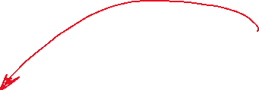

Principles of programmable logic
Example(s)
  Karnaugh map (KM or K-map) = graphical method to express logic functions as SP or PS
    Showing SP case
  Example #5
    $f_{5}\left(a,b\right)=\left(\overline{a}∙c\right)+\left(b∙c\right)$
    Truth table
    KM
a | b | c | y
0 | 0 | 0 | 0
0 | 0 | 1 | 1
0 | 1 | 0 | 0
0 | 1 | 1 | 1
1 | 0 | 0 | 0
1 | 0 | 1 | 0
1 | 1 | 0 | 0
1 | 1 | 1 | 1
How to
  Find all the largest group(s) of contiguous 1s
  For each group, select only the inputs whose value does not change
  Complement surviving inputs whose value is 0
  Multiply the surviving inputs → products $P_{i}$
  Sum the products
 |  | bc
 |  | 00 | 01 | 11 | 10
a | 0 | 0 | 1 | 1 | 0
 | 1 | 0 | 0 | 1 | 0

Slide 56
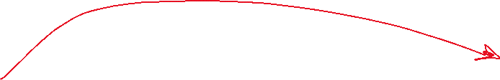

Principles of programmable logic
Example(s)
  Karnaugh map (KM or K-map) = graphical method to express logic functions as SP or PS
    Showing SP case
  Example #5
    $f_{5}\left(a,b\right)=\left(\overline{a}∙c\right)+\left(b∙c\right)$
    Truth table
    KM
a | b | c | y
0 | 0 | 0 | 0
0 | 0 | 1 | 1
0 | 1 | 0 | 0
0 | 1 | 1 | 1
1 | 0 | 0 | 0
1 | 0 | 1 | 0
1 | 1 | 0 | 0
1 | 1 | 1 | 1
Logic circuit
 |  | bc
 |  | 00 | 01 | 11 | 10
a | 0 | 0 | 1 | 1 | 0
 | 1 | 0 | 0 | 1 | 0
a
c
y
b

Slide 57
Principles of programmable logic
Example(s)
  Karnaugh map (KM or K-map) = graphical method to express logic functions as SP or PS
    Showing SP case
    Similar approach can be used for PS
    However, the goal is not to learn how to use Karnaugh maps, but …

Slide 58
Principles of programmable logic*
Example(s)
  Karnaugh map (KM or K-map) = graphical method to express logic functions as SP or PS
    Showing SP case
    Similar approach can be used for PS
    However, the goal is not to learn how to use Karnaugh maps, but …
… demonstrating that
any logic function can be implemented as
a network of AND and OR (and NOT) gates!

Slide 59
PAL*
Earliest PLDs were called Programmable Array Logic (PAL)
  Programmable network of OR, AND, and NOT gates
    Pre-defined network
    Programmable connections among gates
  PROM to program (and re-program) connections

Slide 60
PAL*
Architecture outline

Slide 61

PAL*
Architecture outline

Slide 62

PAL*
Architecture outline

Slide 63




PAL*
Architecture outline

Slide 64
PAL*
Architecture outline
  Do you see familiarity
  with previous examples?

Slide 65

PAL*
Architecture outline
  Do you see familiarity
  with previous examples?
    Recalling example #5
      $f_{5}\left(a,b\right)=\left(\overline{a}∙c\right)+\left(b∙c\right)$

Slide 66




PAL*
Architecture outline
  Do you see familiarity
  with previous examples?
    Recalling example #5
      $f_{5}\left(a,b\right)=\left(\overline{a}∙c\right)+\left(b∙c\right)$
= non-programmed node (open circuit)
= programmed node (short circuit)

Slide 67



PAL*
Architecture outline
  Do you see familiarity
  with previous examples?
    Recalling example #5
      $f_{5}\left(a,b\right)=\left(\overline{a}∙c\right)+\left(b∙c\right)$
= non-programmed node (open circuit)
= programmed node (short circuit)

Slide 68
PAL*
Architecture outline
  AND plane

Slide 69
PAL*
Architecture outline
AND plane 1
AND plane 2
AND plane 3

Slide 70
PAL*
Architecture outline
  Do you see familiarity
  with previous examples?
AND plane 1
AND plane 2
AND plane 3

Slide 71
PAL*
Architecture outline
  Do you see familiarity
  with previous examples?
    Recalling example #5
      $f_{5}\left(a,b\right)=\left(\overline{a}∙c\right)+\left(b∙c\right)$
AND plane 1
AND plane 2
AND plane 3

Slide 72





PAL*
Architecture outline
  Do you see familiarity
  with previous examples?
    Recalling example #5
      $f_{5}\left(a,b\right)=\underset{P_{0}}{\underbrace{\left(\overline{a}∙c\right)}}+\underset{P_{1}}{\underbrace{\left(b∙c\right)}}$
AND plane 1
AND plane 2
AND plane 3

Slide 73





PAL*
Architecture outline
  Do you see familiarity
  with previous examples?
    Recalling example #5
      $f_{5}\left(a,b\right)=\underset{P_{0}}{\underbrace{\left(\overline{a}∙c\right)}}+\underset{P_{1}}{\underbrace{\left(b∙c\right)}}$
AND plane 1
AND plane 2
AND plane 3

Slide 74
PAL*
Programmable connection(s)
  Connecting input to AND gate
  Determining the type of PAL/PLD
    OTP = One-Time Programmable
      Fuse/Anti-fuse
    Reprogrammable
      UV-EPROM style (FAMOS)
      Flash memory style (Flash transistor)
to AND gate
Input pin

Slide 75
PAL*
Programmable connection(s)
  Connecting input to AND gate
  Determining the type of PAL/PLD
    OTP = One-Time Programmable
      Fuse/Anti-fuse
    Reprogrammable
      UV-EPROM style (FAMOS)
      Flash memory style (Flash transistor)
to AND gate
Input pin
Similar to memory (ROM):
Word Line = input pin
Bit Line = AND gate input

Slide 76

PAL*
OTP PAL
  Fuse
to AND gate
$a$

Slide 77




PAL*
OTP PAL
  Fuse
    Default (Fuse not vaporized)
      Input pin ($a$) connected to the AND gate
to AND gate
$a$

Slide 78


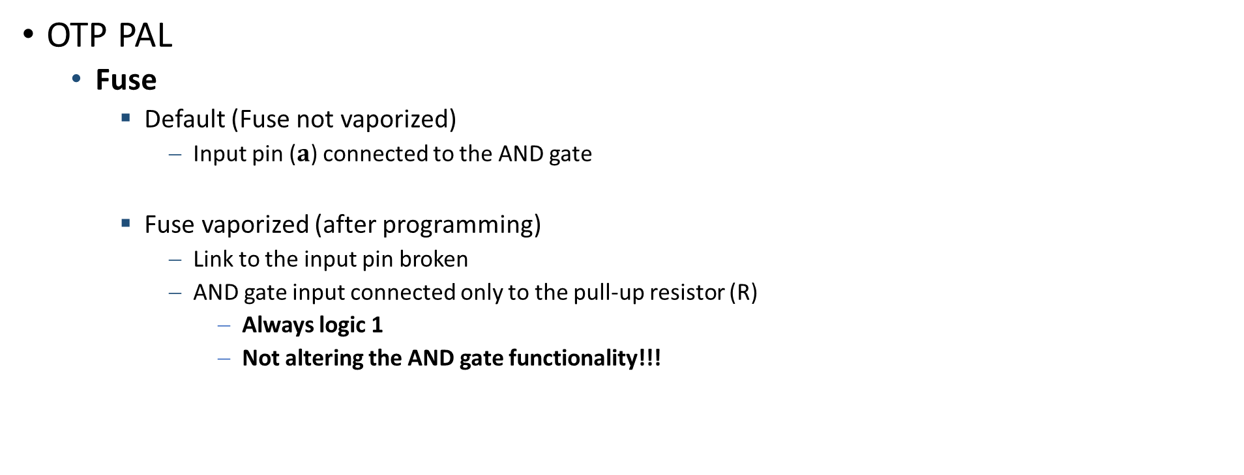


PAL*
OTP PAL
  Fuse
    Default (Fuse not vaporized)
      Input pin ($a$) connected to the AND gate
    Fuse vaporized (after programming)
      Link to the input pin broken
      AND gate input connected only to the pull-up resistor (R)
        Always logic 1
        Not altering the AND gate functionality!!!
to AND gate
$a$

Slide 79
PAL*
Reprogrammable PAL
  UV erasable (FAMOS)
to AND gate
$a$

Slide 80

PAL*
Reprogrammable PAL
  UV erasable (FAMOS)
    Default (FAMOS not programmed)
      If input pin ($a$) = logic 1 ($V_{CC}>V_{T}$) → transistor ON
        AND gate input = logic 0
to AND gate
$a$

Slide 81

PAL*
Reprogrammable PAL
  UV erasable (FAMOS)
    Default (FAMOS not programmed)
      If input pin ($a$) = logic 1 ($V_{CC}>V_{T}$) → transistor ON
        AND gate input = logic 0
      If input pin ($a$) = logic 1 ($0 V<V_{T}$) → transistor OFF
        AND gate input = logic 1
to AND gate
$a$

Slide 82
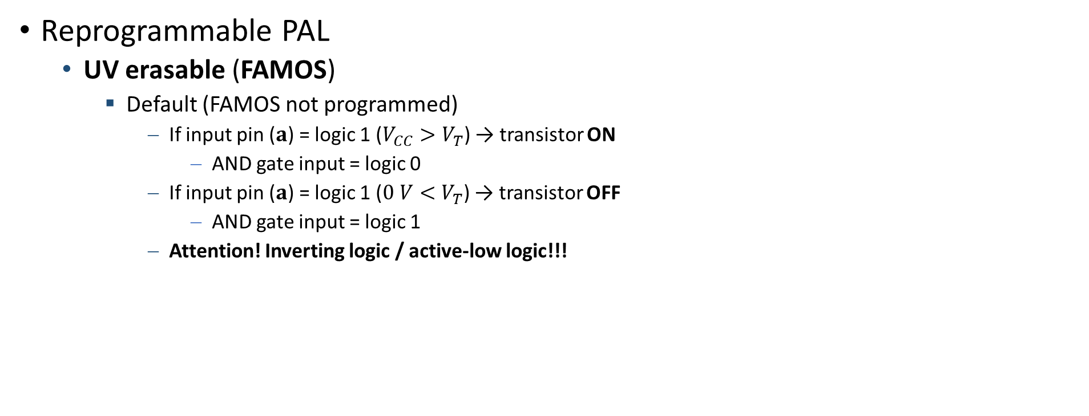

PAL*
Reprogrammable PAL
  UV erasable (FAMOS)
    Default (FAMOS not programmed)
      If input pin ($a$) = logic 1 ($V_{CC}>V_{T}$) → transistor ON
        AND gate input = logic 0
      If input pin ($a$) = logic 1 ($0 V<V_{T}$) → transistor OFF
        AND gate input = logic 1
      Attention! Inverting logic / active-low logic!!!
to AND gate
$a$

Slide 83

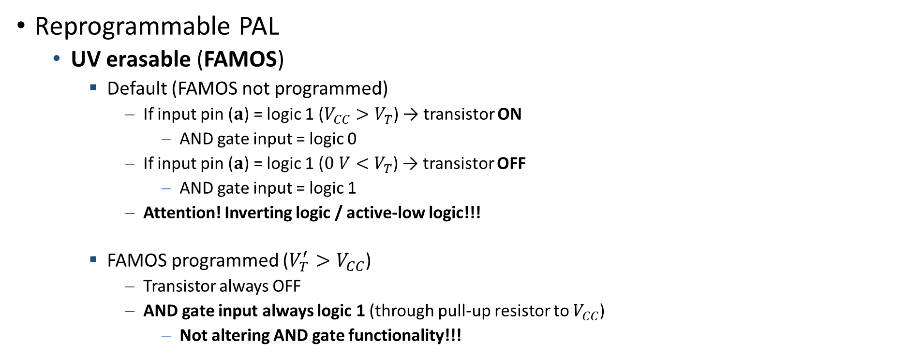


PAL*
Reprogrammable PAL
  UV erasable (FAMOS)
    Default (FAMOS not programmed)
      If input pin ($a$) = logic 1 ($V_{CC}>V_{T}$) → transistor ON
        AND gate input = logic 0
      If input pin ($a$) = logic 1 ($0 V<V_{T}$) → transistor OFF
        AND gate input = logic 1
      Attention! Inverting logic / active-low logic!!!
    FAMOS programmed ($V_{T}^{′}>V_{CC}$)
      Transistor always OFF
      AND gate input always logic 1 (through pull-up resistor to $V_{CC}$)
        Not altering AND gate functionality!!!
to AND gate
$a$

Slide 84
Evolution of PAL*
Output polarity configuration: active-high / active-low
AND plane 1
AND plane 2
AND plane 3

Slide 85
Evolution of PAL*
Output polarity configuration: active-high / active-low
AND plane 1
AND plane 2
AND plane 3

Slide 86


Evolution of PAL*
Output polarity configuration: active-high / active-low
AND plane 1
AND plane 2
AND plane 3

Slide 87


Evolution of PAL*
Output polarity configuration: active-high / active-low
AND plane 1
AND plane 2
AND plane 3

Slide 88

Evolution of PAL*
Output polarity configuration: active-high / active-low
AND plane 1
AND plane 2
AND plane 3

Slide 89

Evolution of PAL*
Registered output for sequential logic
AND plane 1
AND plane 2
AND plane 3

Slide 90
Evolution of PAL*
Feedback path for FSM implementation
AND plane 1
AND plane 2
AND plane 3

Slide 91
Evolution of PAL*
MUX to select between combinational or sequential output
AND plane 1
AND plane 2
AND plane 3

Slide 92
Evolution of PAL*
PAL has evolved by enriching its functionality/flexibility
Evolution to more complex PLDs (CPLDs) to the latest and most powerful configurable device
  FPGA = Field-Programmable Gate Array
PAL
CPLD
FPGA

Slide 93
PAL – Last notes*
How PALs were programmed
  Dedicated equipment
  Programming language
    PALASM (PAL Assembler)
    CUPL (Compiler for Universal Programmable Logic)
    ABEL (Advanced Boolean Expression Language)

Slide 94
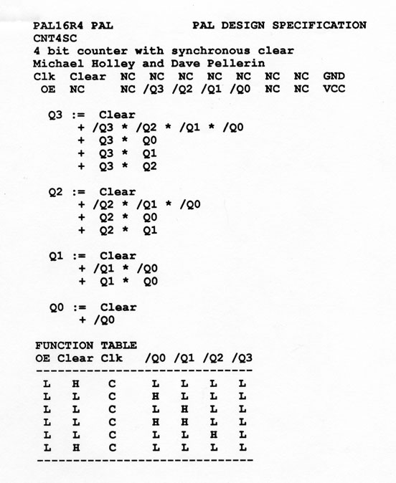
PAL – Last notes*
How PALs were programmed
  Dedicated equipment
  Programming language
    PALASM (PAL Assembler)
    CUPL (Compiler for Universal Programmable Logic)
    ABEL (Advanced Boolean Expression Language)

Slide 95
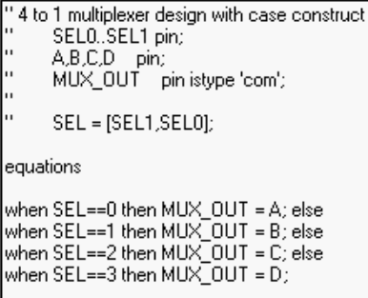
PAL – Last notes*
How PALs were programmed
  Dedicated equipment
  Programming language
    PALASM (PAL Assembler)
    CUPL (Compiler for Universal Programmable Logic)
    ABEL (Advanced Boolean Expression Language)

Slide 96
PAL – Last notes*
How PALs were programmed
  Dedicated equipment
  Programming language
    PALASM (PAL Assembler)
    CUPL (Compiler for Universal Programmable Logic)
    ABEL (Advanced Boolean Expression Language)
First examples of HDL

